Slide 1
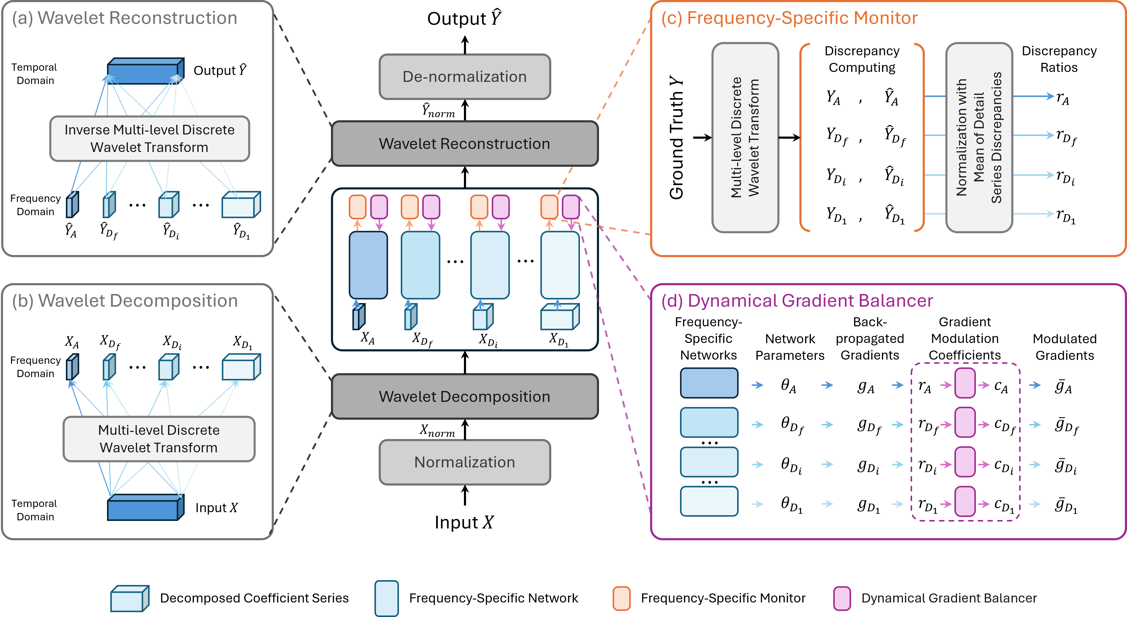

Slide 2
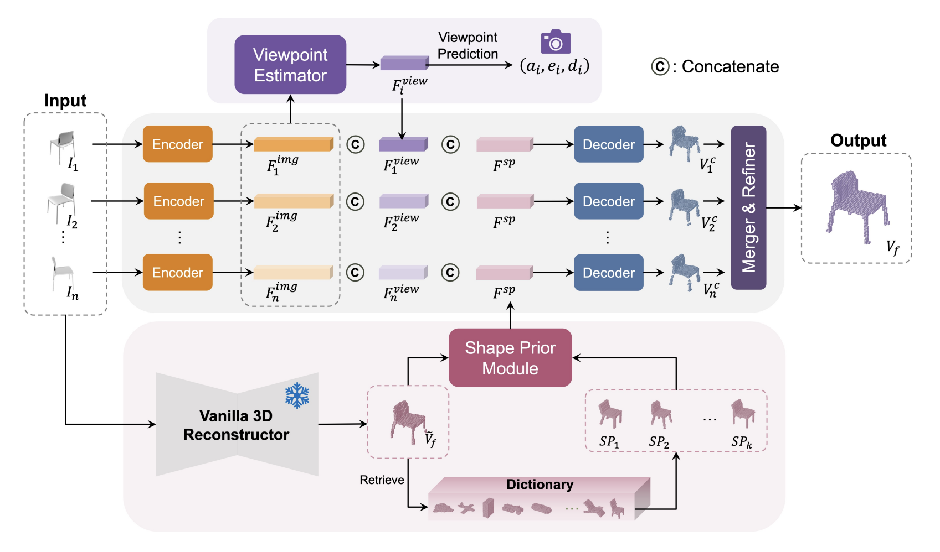
Notes:
2024 ACCV VIPNet

Slide 3
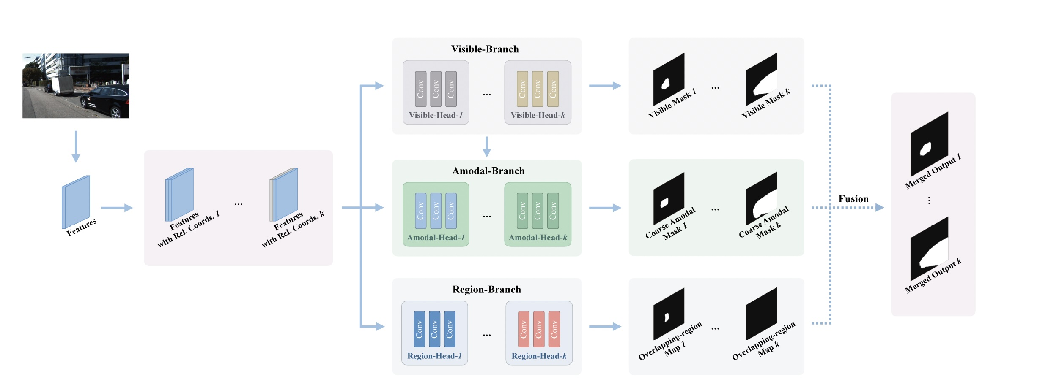

Slide 4
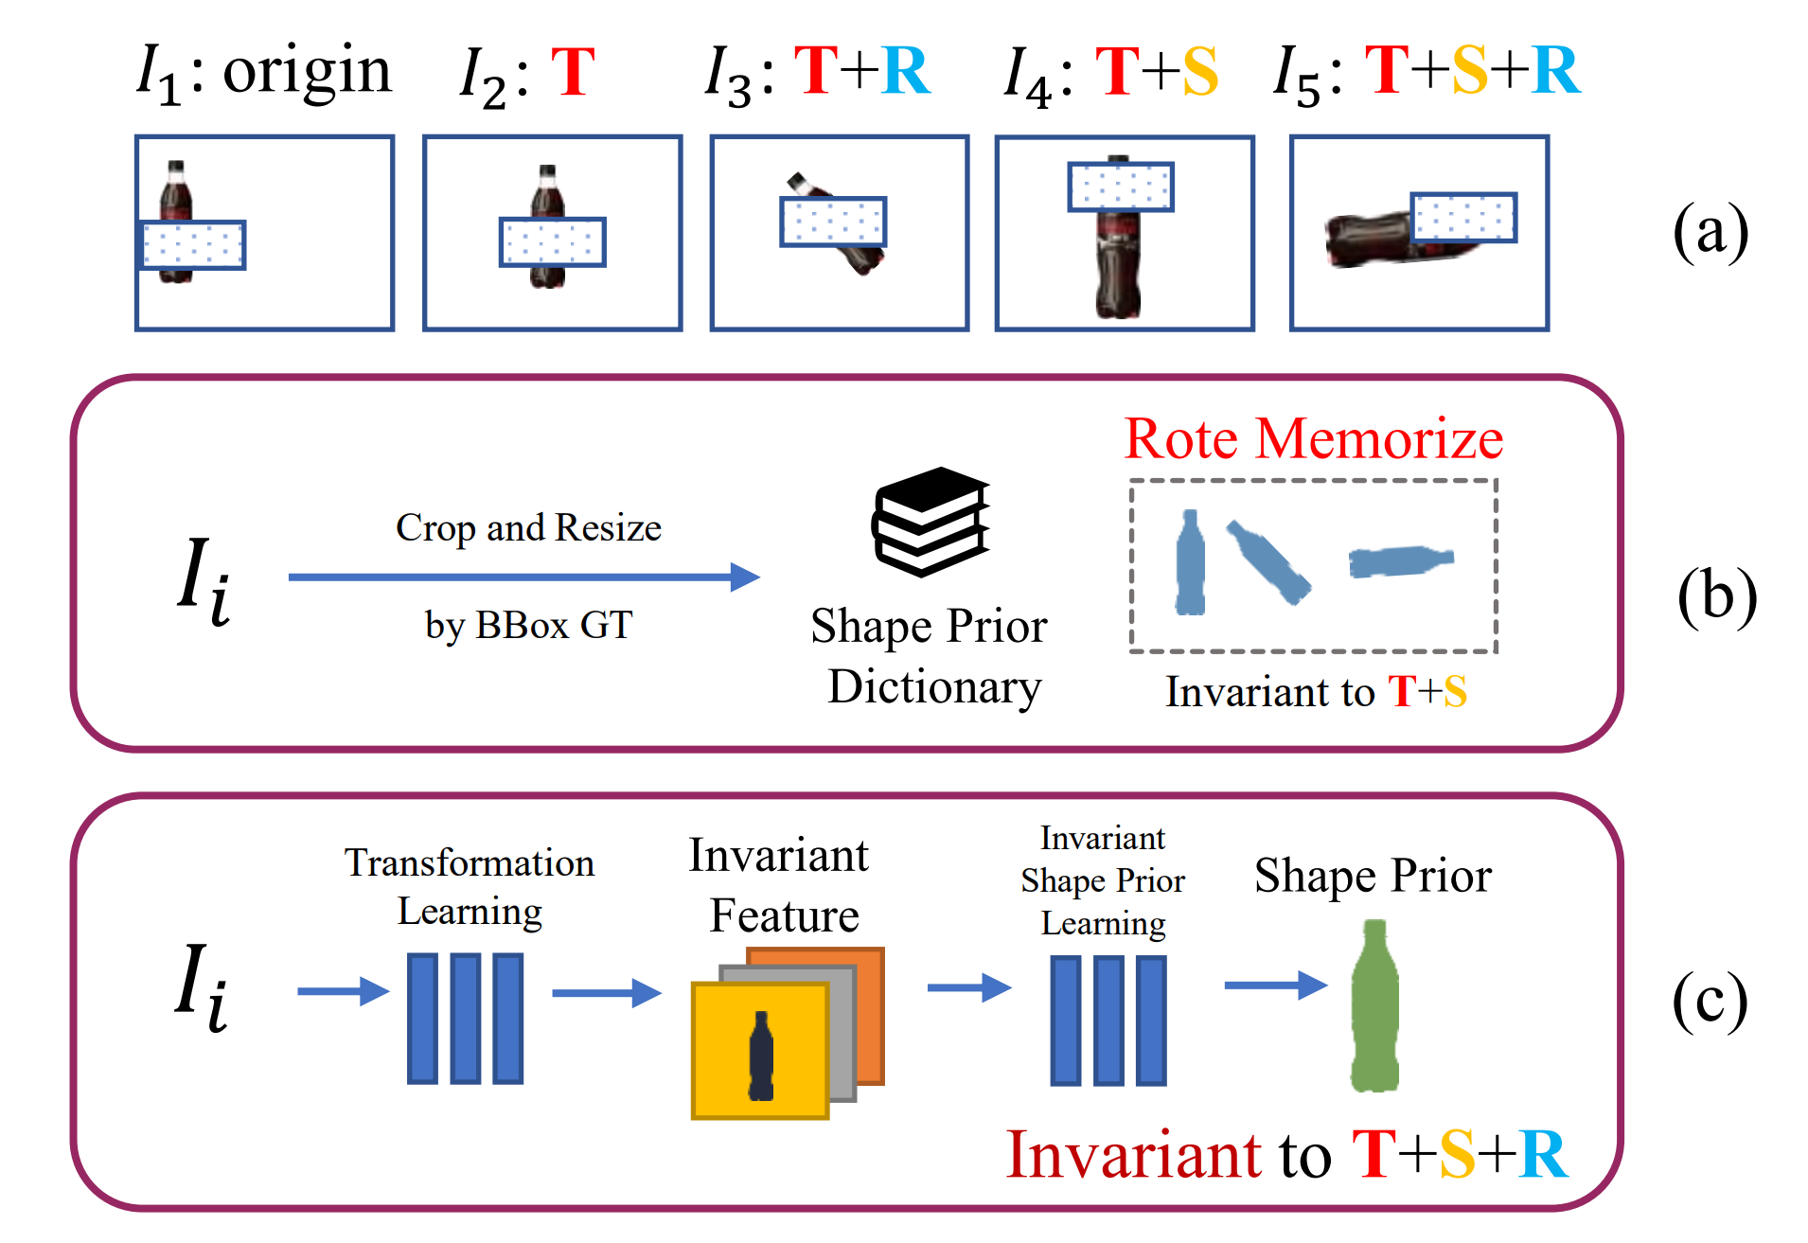

Slide 5
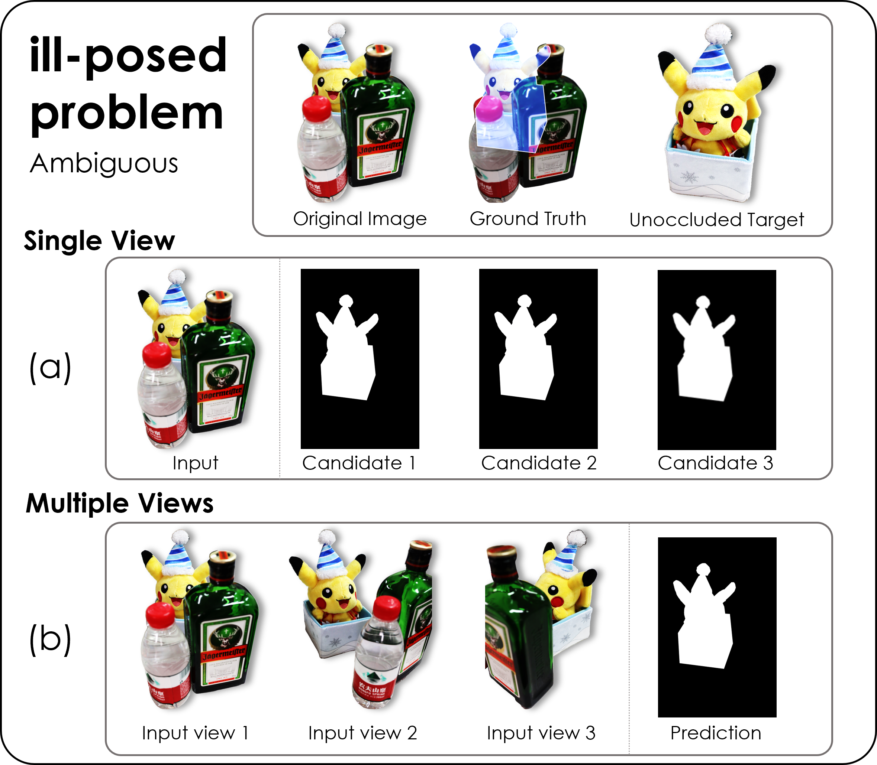
Notes:
2023_ICCV_MUVA

Slide 6
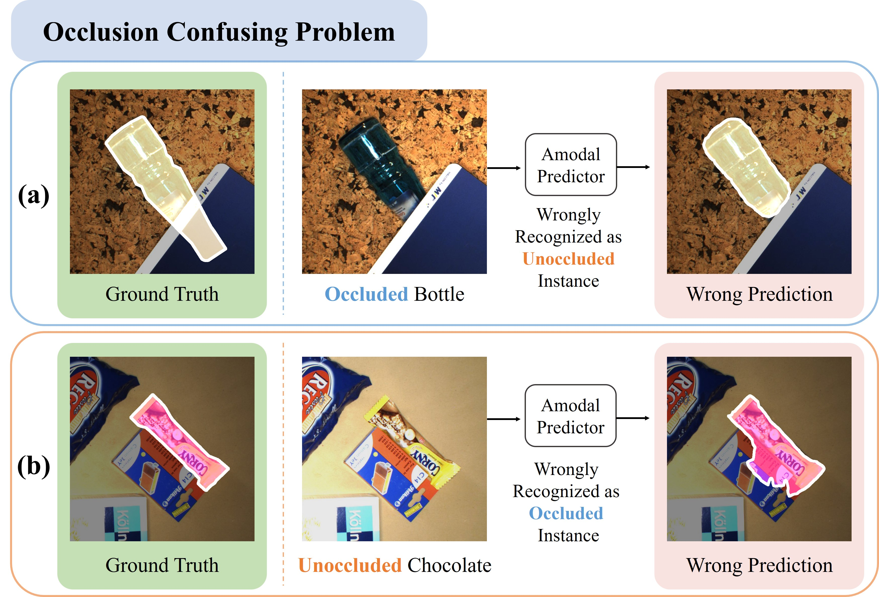
Notes:
2023_ICASSP_OAFormer

Slide 7
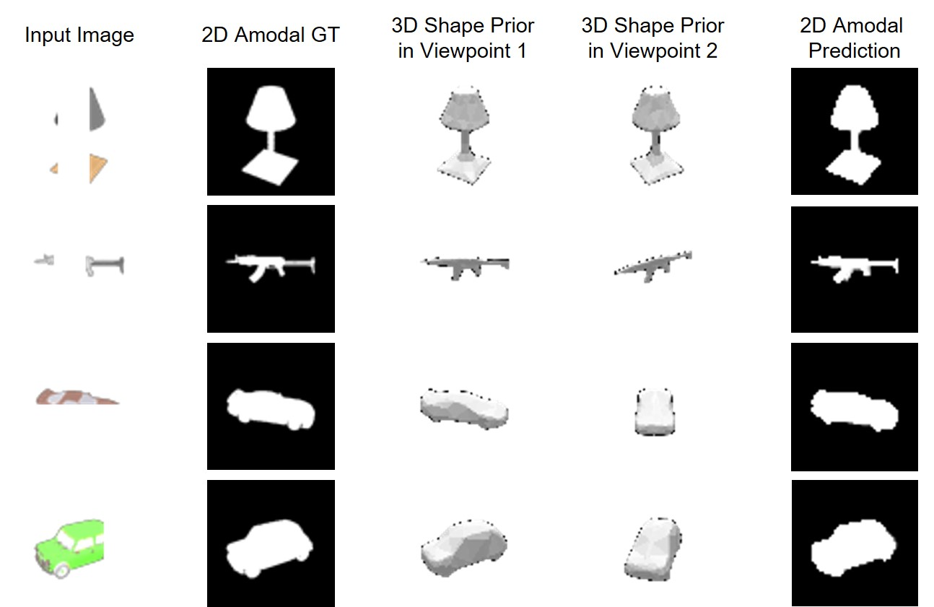
Notes:
2022_ECCV_A3D

Slide 8
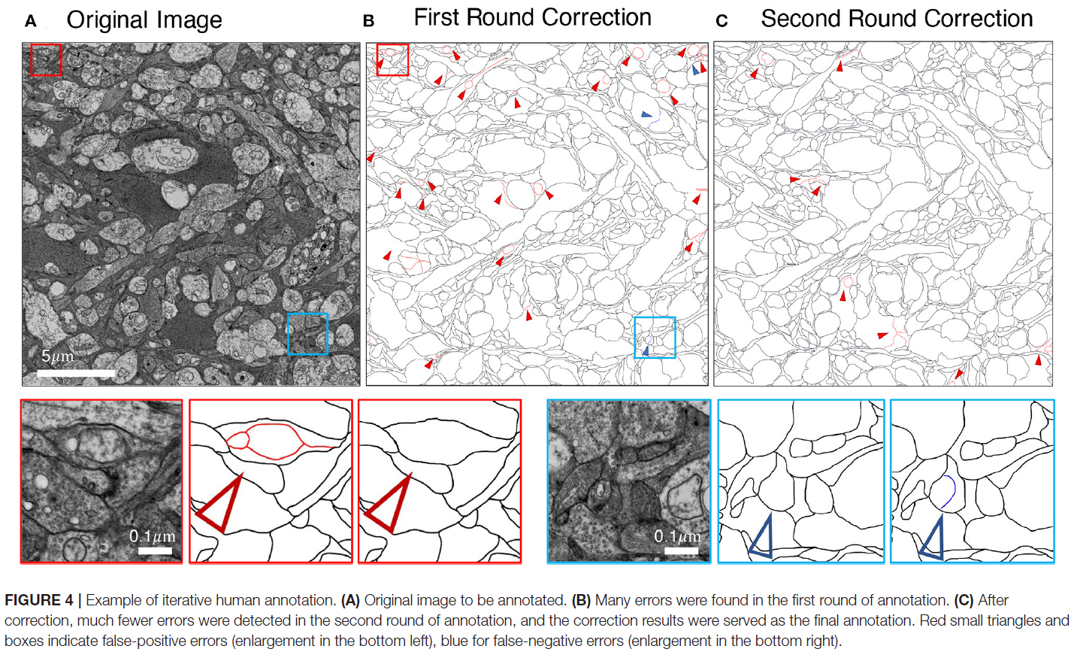
Notes:
2022_Frontiers

Slide 9
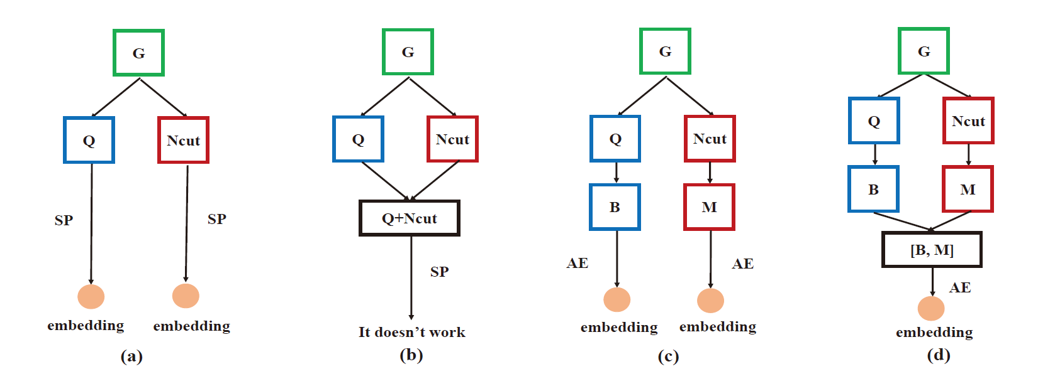
Notes:
2017_ICTAI

Slide 10
